Slide 1
Integral Sliding Mode for the Torque Vectoring Control of Fully Electric Vehicles Theoretical Design and Experimental Assessment
SMEET Lab 김진민

Slide 2
Vehicle Model
Vehicle Model
This Paper emphasizes the real-world vehicle Model
In the limited range of parameter, second order ISM show great performance, but out of range is not
Such side slip angle control, unknown parameter use ISM is better than PID Controoler
Notes:
Magic Formula Tire Model 사용해서 타이어 모델 구성

Slide 3
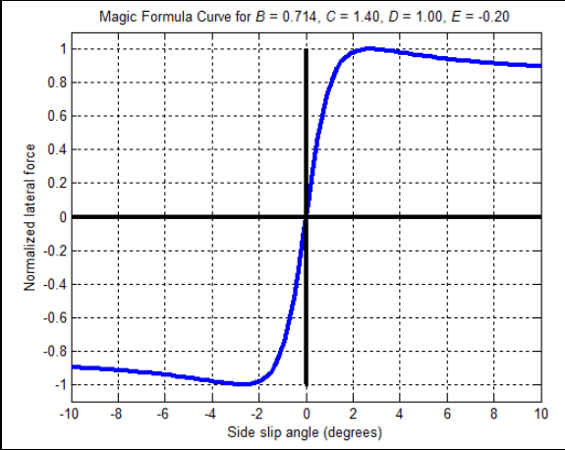
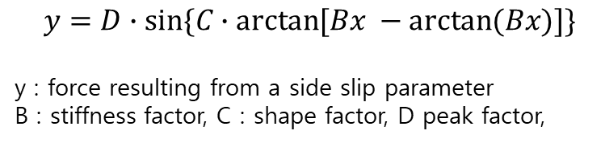
Vehicle Model
Tire Model
Magic Formula Tire models
$$y=D∙sin⁡\{C∙arctan⁡[Bx −arctan⁡(Bx)]\}$$
y : force resulting from a side slip parameter
B : stiffness factor, C : shape factor, D peak factor,
Notes:
Magic Formula Tire Model 사용해서 타이어 모델 구성

Slide 4
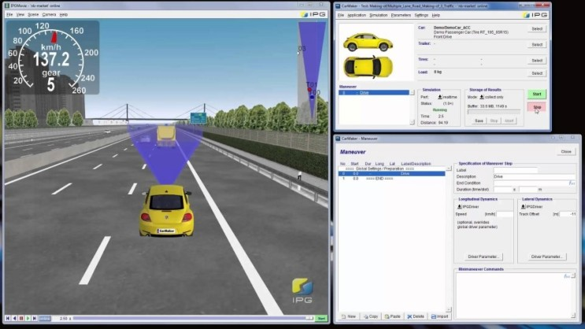
Vehicle Model
CarMaker simulator

Slide 5
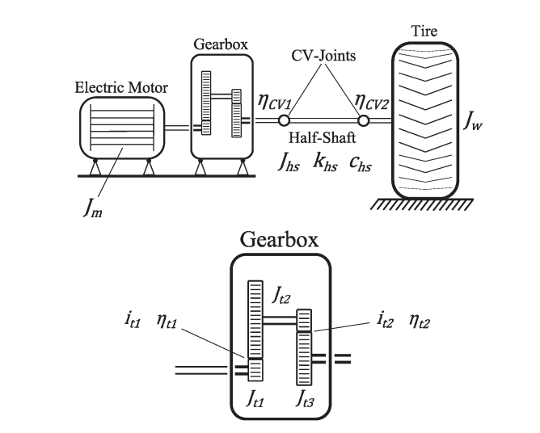
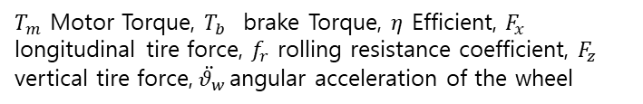

Vehicle Model
In-Wheel Drivetrain Layout
$$\frac{T_{m}η }{i} −T_{b} −F_{x}R_{l}−f_{r}F_{z}R_{l}=(J_{w}+J+\frac{J_{m}η}{i^{2}})\ddot{θ_{w}}$$
$T_{m}$ Motor Torque, $T_{b}$ brake Torque, $η$ Efficient, $F_{x}$ longitudinal tire force, $f_{r}$ rolling resistance coefficient, $F_{z}$ vertical tire force,$\ddot{{ θ}_{w}}$angular acceleration of the wheel
Notes:
T_m

Slide 6
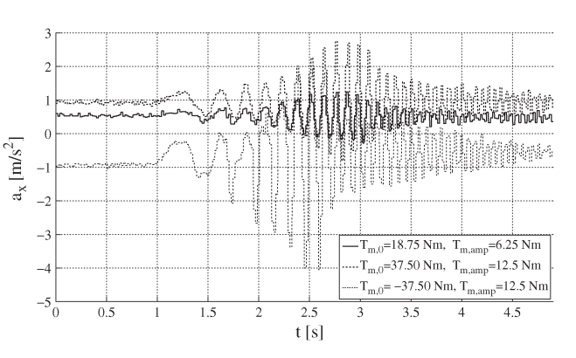

Vehicle Model
Potential impact of the drivetrain dynamics
$$T_{m,dem}=T_{m,0}+T_{m,amp}sim(2φG_{f}t^{2})$$
Notes:
T_m

Slide 7

Vehicle Model
Delay Model
All Signals have delays, and they effect the model’s performance
Delay is uniformly distributed between upper and lower boundaries
$$t_{d,Comm}=t_{d,Send}+t_{d,Trs}+t_{d,Rcv}$$
$t_{d,send}t_{dmRcv}$ These are calculated as constant variable
$$t_{d,Trsm}=t_{jitter}+t_{queue}+t_{c}$$
Notes:
T_m

Slide 8
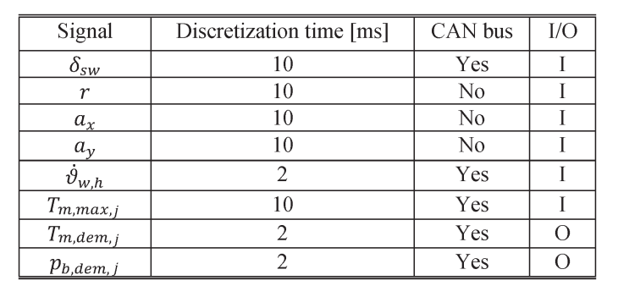
Vehicle Model
Discretization Time
Sensor data is not infinte frequency, and this effects the sliding modes
Notes:
T_m

Slide 9
Vehicle Model
Discretization Time
Sensor data is not infinte frequency, and this effects the sliding modes
Notes:
T_m

Slide 10
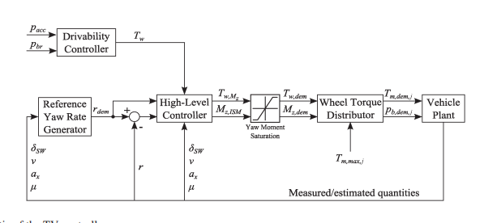
Torque Vectoring
TV Controller
Notes:
T_m

Slide 11

Torque Vectoring
Max Torque
$$\left|T_{w,max,j}\right|=μ_{x,j}F_{z,j}R_{l}$$
$−\left|T_{w,max,1/2}\right|≤$ $\frac{T_{w,m_{z}}τ_{T,F}}{2}∓ \frac{M_{z,ISM}}{C_{F}} τ_{M,F}R_{l}≤$ $\left|T_{w,max,1/2}\right|$
$−\left|T_{w,max,3/4}\right|≤$ $\frac{T_{w,m_{z}}(1−τ_{T,F})}{2}∓ <\frac{M_{z,ISM}}{C_{R}}\left(1−τ_{M,F}\right)R_{l}≤$ $\left|T_{w,max,3/4}\right|$
$$M_{z,max}=min\left(\begin{matrix}\frac{c_{F}}{τ_{M,F}R_{l}}(\left|T_{w,max,1/2}\right|±\frac{T_{w,m_{z}}τ_{T,F}}{2}) \\ \frac{c_{R}}{(1−τ_{T,F})R_{l}}±\frac{T_{w,m_{z}}(1−τ_{T,F})}{2}\end{matrix}\right)$$
$$M_{z,min}=max\left(\begin{matrix}−\frac{c_{F}}{τ_{M,F}R_{l}}(\left|T_{w,max,1/2}\right|±\frac{T_{w,m_{z}}τ_{T,F}}{2}) \\ −\frac{c_{R}}{(1−τ_{T,F})R_{l}}±\frac{T_{w,m_{z}}(1−τ_{T,F})}{2}\end{matrix}\right)$$
Notes:
T_m

Slide 12
Torque Vectoring
ISM Controller
Sliding Motion immediately start
Guarantee Smooth control action
Need another robustness control, in this paper PID
In this paper, thie ISM Controller is used to compensate for the pid controller
Notes:
T_m

Slide 13
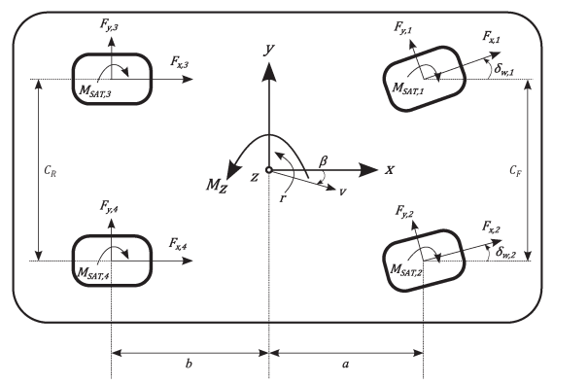

Torque Vectoring
Vehicle Yaw moment equation
$J_{z}\dot{r}=\left(−F_{y,2}sinδ_{w,2}+F_{y,1}sinδ_{w,1}+F_{x,2}cosδ_{w,2}−F_{x,1}cosδ_{w,1}\right)\frac{C_{F}}{2}+\left(−F_{y,2}cosδ_{w,2}+F_{y,1}cosδ_{w,1}+F_{x,2}sinδ_{w,2}+F_{x,1}sinδ_{w,1}\right)a−\left(F_{y,4}+F_{y,3}\right)b+\left(F_{x,4}−F_{x,3}\right)\frac{C_{R}}{2}−M_{SAT,1}−M_{SAT,2}$- $M_{SAT,2}$- $M_{SAT,4}$
Notes:
T_m

Slide 14

Torque Vectoring
Vehicle Yaw moment equation
Control value
$$M_{z,F_{x}}=\left(F_{x,2}cosδ_{w,2}−F_{x,1}cosδ_{w,1}\right)\frac{C_{F}}{2}+\left(F_{x,2}sinδ_{w,2}+F_{x,1}sinδ_{w,1}\right)a+\left(F_{x,4}−F_{x,3}\right)\frac{C_{R}}{2}$$
Dependent value
$$k\left(r,β,δ_{w,j}\right)=\frac{1}{J_{z}}[\left(−F_{y,2}sinδ_{w,2}+F_{y,1}sinδ_{w,1}\right)\frac{C_{F}}{2}+\left(+F_{y,2}cosδ_{w,2}+F_{y,1}cosδ_{w,1}\right)a−\left(F_{y,4}+F_{y,3}\right)b−M_{SAT,1}−M_{SAT,2}\text{− }M_{SAT,2}\text{− }M_{SAT,4}]$$
Notes:
T_m

Slide 15

Torque Vectoring
$$M_{z,F_{x}}=\left(F_{x,2}cosδ_{w,2}−F_{x,1}cosδ_{w,1}\right)\frac{C_{F}}{2}+\left(F_{x,2}sinδ_{w,2}+F_{x,1}sinδ_{w,1}\right)a+\left(F_{x,4}−F_{x,3}\right)\frac{C_{R}}{2}$$
Dependent value
$$k\left(r,β,δ_{w,j}\right)=\frac{1}{J_{z}}[\left(−F_{y,2}sinδ_{w,2}+F_{y,1}sinδ_{w,1}\right)\frac{C_{F}}{2}+\left(+F_{y,2}cosδ_{w,2}+F_{y,1}cosδ_{w,1}\right)a−\left(F_{y,4}+F_{y,3}\right)b−M_{SAT,1}−M_{SAT,2}\text{− }M_{SAT,2}\text{− }M_{SAT,4}]$$
Notes:
T_m

